Slide 1
Disease-Drug Interactions using Network Analysis
Pooja Satish, Sandhya Venkataramaiah, Tanvi Hadgaonkar

Slide 2

Introduction
Why do we need Disease-Drug Interactions?
Essential for effective healthcare and personalized medicine.
Predicts drug efficacy, side effects, and impacts on disease progression.
Aids in discovering new uses for existing drugs.
Alzheimer’s
A chronic, progressive neurodegenerative disorder causing dementia.
Accounts for up to 75% of dementia cases.
Features cognitive impairment, behavioral changes, and loss of bodily functions.

Slide 3
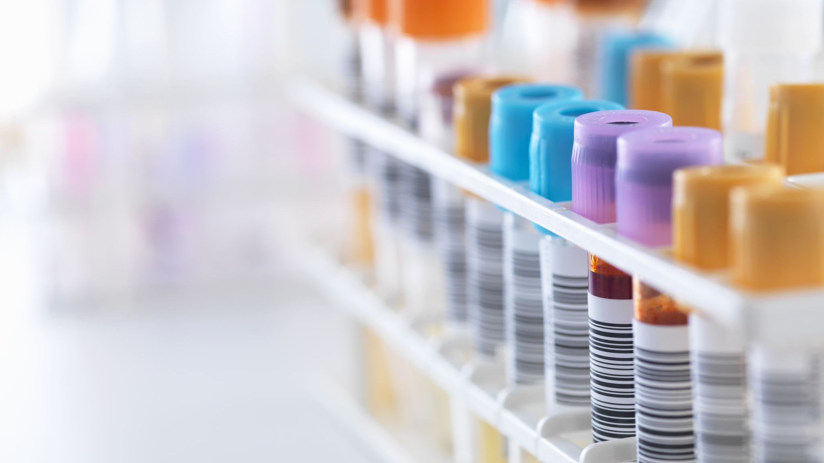
Current Scenario
Current treatments have limited efficacy and often don't address the underlying causes of Alzheimer's, underscoring the need for drug repurposing to explore more effective solutions.
Recent treatment developments are promising but require more validation.

Slide 4

Background
Inspired by the paper "Network-based stage-specific drug repurposing for Alzheimer’s disease."
Involves repurposing existing drugs using network analysis and blood-brain barrier penetration evaluation.
Identifies 26 candidate drugs for various Alzheimer's stages.

Slide 5

Data
Selected 26 candidate drugs for Alzheimer's analysis from the Bio-SNAP database of disease-drug associations, which includes 124 drugs being tested for Alzheimer’s.
Bio-SNAP database details: 5,535 disease nodes, 1,662 drug nodes, and 466,656 edges.
Utilized Alzheimer’s Association database for information on 8 FDA-approved drugs for Alzheimer's treatment.

Slide 6

Data
Referenced PubMed Central for drugs that failed in Alzheimer’s clinical trials, reviewing over 2,700 trials.
Considered all clinical trial phases (I, II, and III) for validation, identifying a total of 143 drugs (31 from Phase III, 82 from Phase II, and 30 from Phase I).
CoDReS scores from the CoDReS Database used for calculating structural and functional scores for each candidate drug against Alzheimer's.

Slide 7
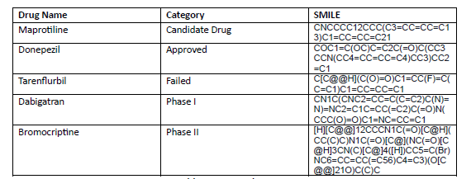
Data Preprocessing
For our analysis, we utilized 26 candidate drugs. After gathering all the drugs from each category, we obtained their SMILE scores from DrugBank to calculate the Tanimoto coefficient. Below are examples of some of the SMILE scores.

Slide 8
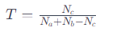
Tanimoto Similarity Coefficient
Na​ is the number of elements in set A, Nb​ is the number of elements in set B, and Nc​ is the number of elements that are shared in A and B. The Tanimoto Coefficient ranges from 0 (no bits in common) to 1 (all bits the same)
The Tanimoto similarity identifies drugs structurally similar to approved or trial-phase drugs and distinct from failed ones, aiding in selecting promising Alzheimer's candidates.
It is a ratio measuring shared features between two molecules relative to their total features, with values ranging from 0 to 1.

Slide 9
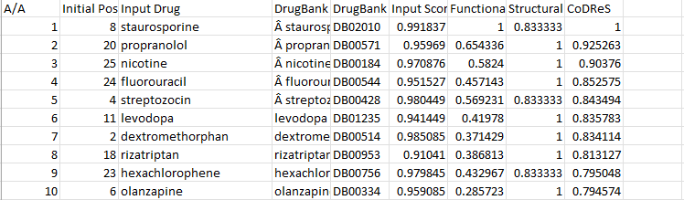
CoDReS
CoDReS is a metric for ranking candidate drugs against diseases based on functional and structural criteria.
Measures how structurally and functionally similar a candidate drug is to existing effective drugs for a particular disease.
Assists in identifying drugs with potential efficacy for diseases they were not originally designed to treat.
Useful in drug repurposing, leveraging similarities to known effective drugs to find new treatment options.

Slide 10
Methodology
Detailed comparison of a wide range of drugs for Alzheimer's, including approved, failed, or in clinical trials, focusing on structural similarity using the Tanimoto coefficient (threshold ≥ 0.5).
Formation and analysis of a drug network based on structural similarities, utilizing node-level metrics like betweenness, closeness, PageRank, and eigenvector centralities.
Network-based approach to identify key drugs for Alzheimer's, advancing beyond traditional drug discovery by leveraging connection and interaction patterns.

Slide 11
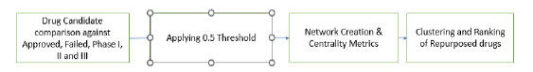
Methodology
Implementation of a clustering exercise based on CoDRes (Coefficient of Drug Repurposing), assessing a drug's potential for Alzheimer's repurposing.
Grouping of structurally similar drugs to identify and highlight the top 10 most promising candidates for repurposing.

Slide 12
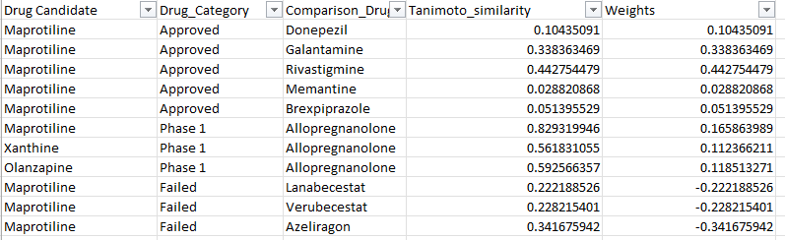
Network Creation
In our model, drugs are depicted as nodes, and their interconnections, or edges, are assigned weights based on this coefficient. Approved drugs are given a weight of 1, failed drugs -1, and drugs in different trial phases receive incremental weights (0.2 for Phase I, 0.4 for Phase II, 0.6 for Phase III).

Slide 13
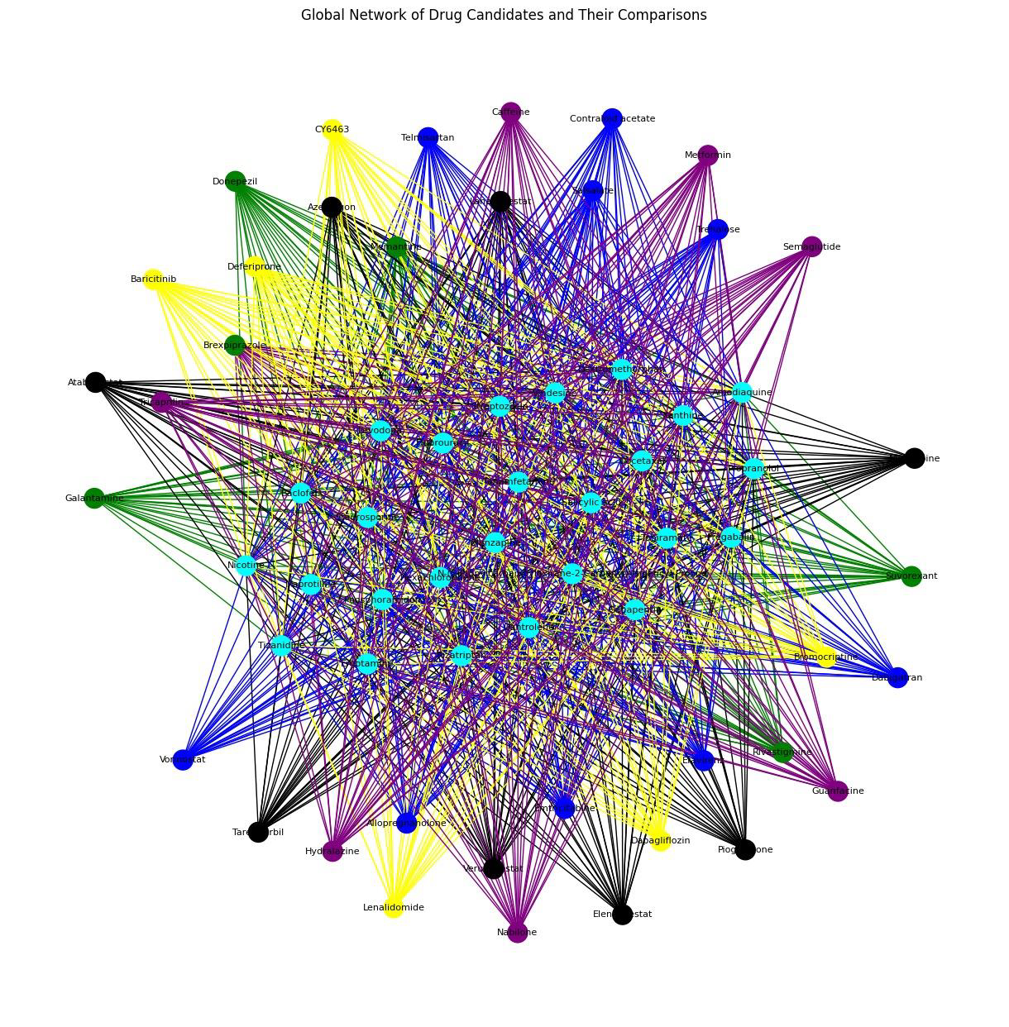
Global Network
This network consists of 62 nodes and 936 edges in total.

Slide 14
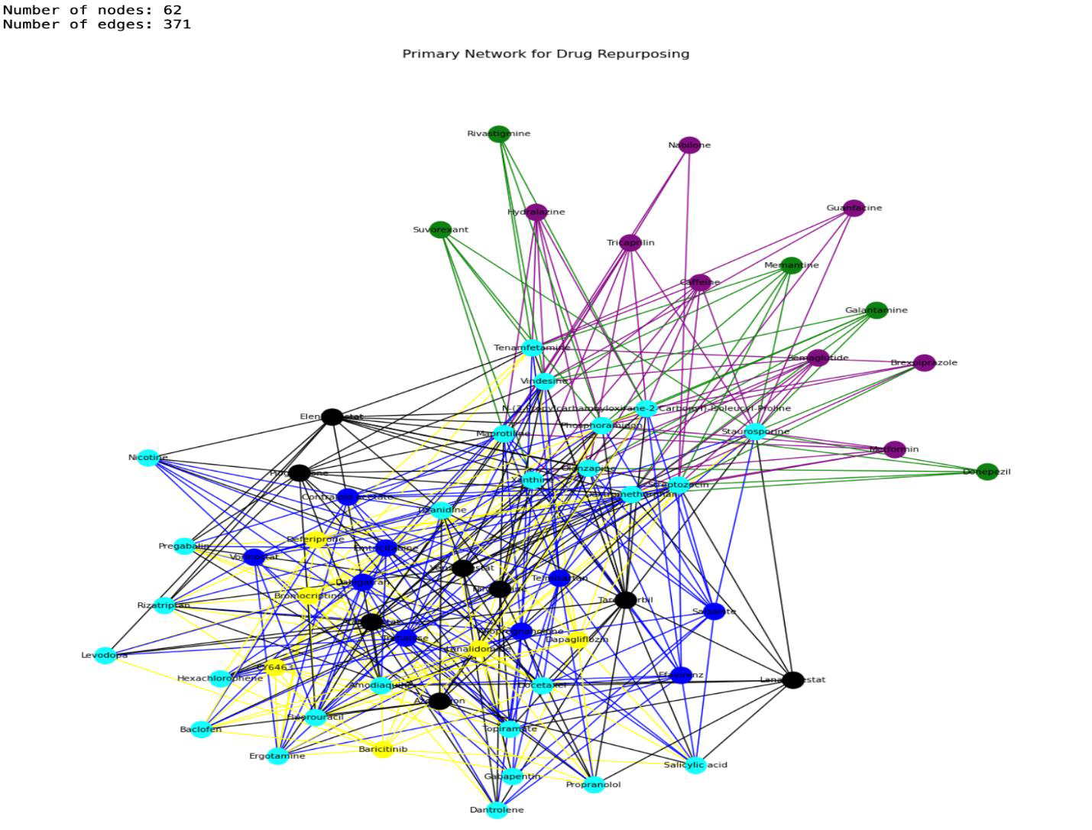
Primary Drug Repurposing Network
Post applying a threshold of 0.5 Tanimoto coefficient with 62 nodes, 371 edges.

Slide 15
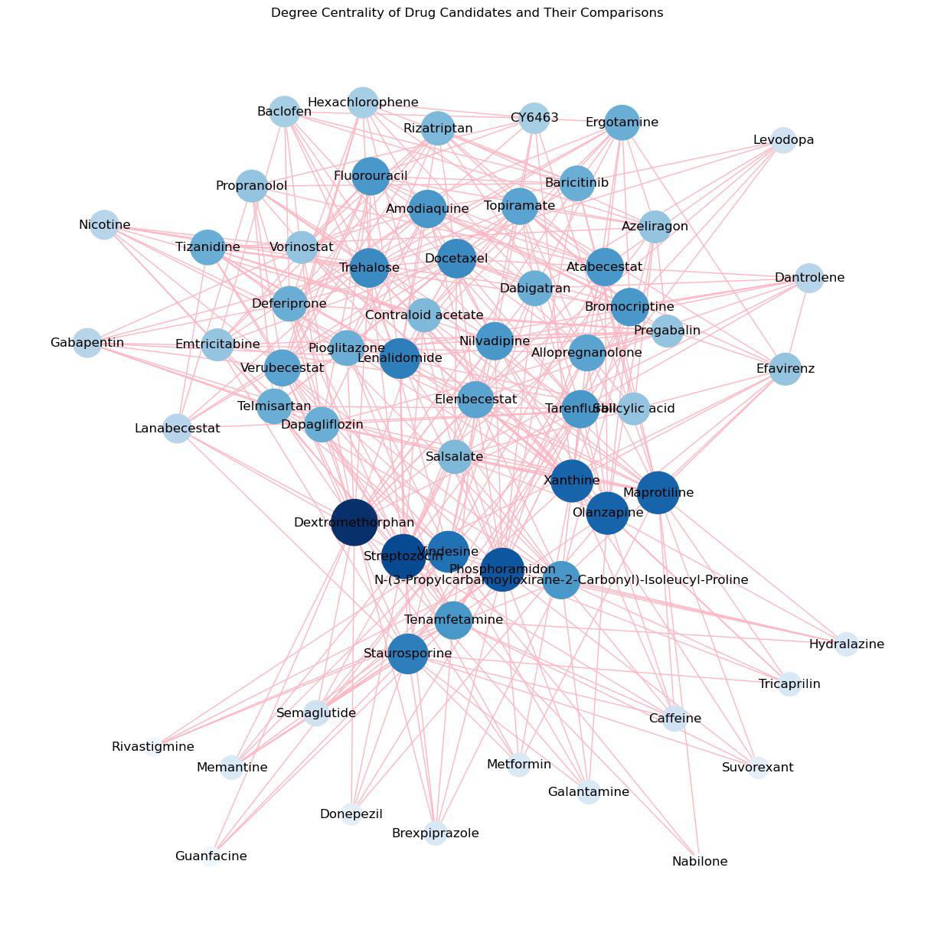
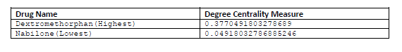
Degree Centrality

Slide 16
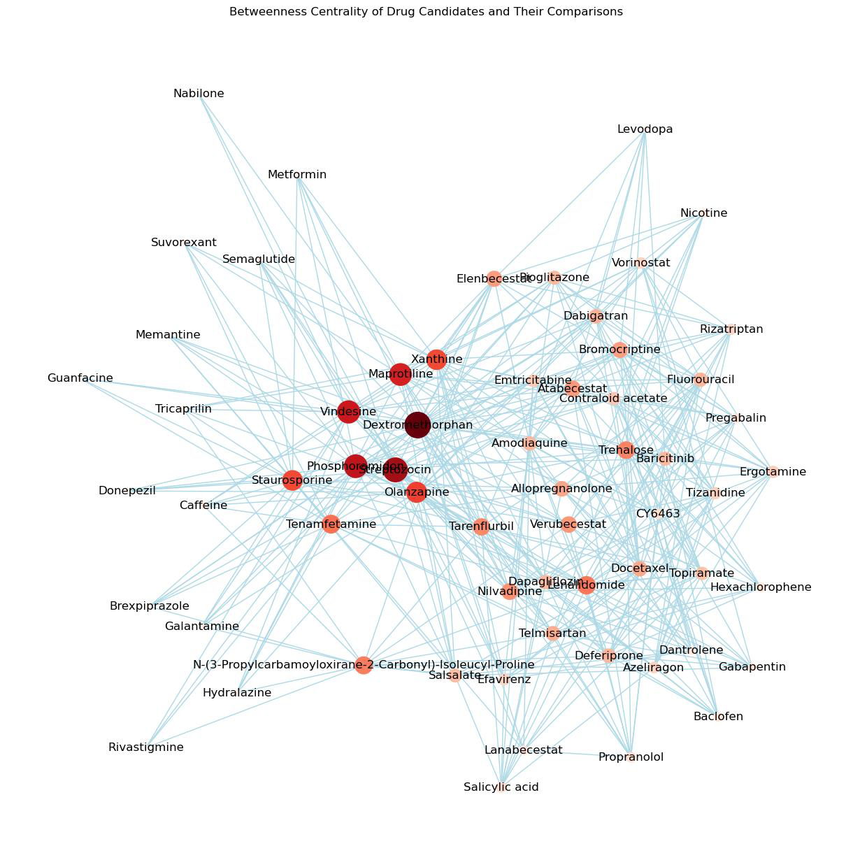
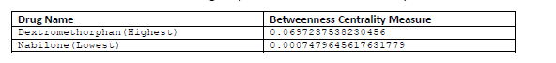
Betwenness Centrality

Slide 17
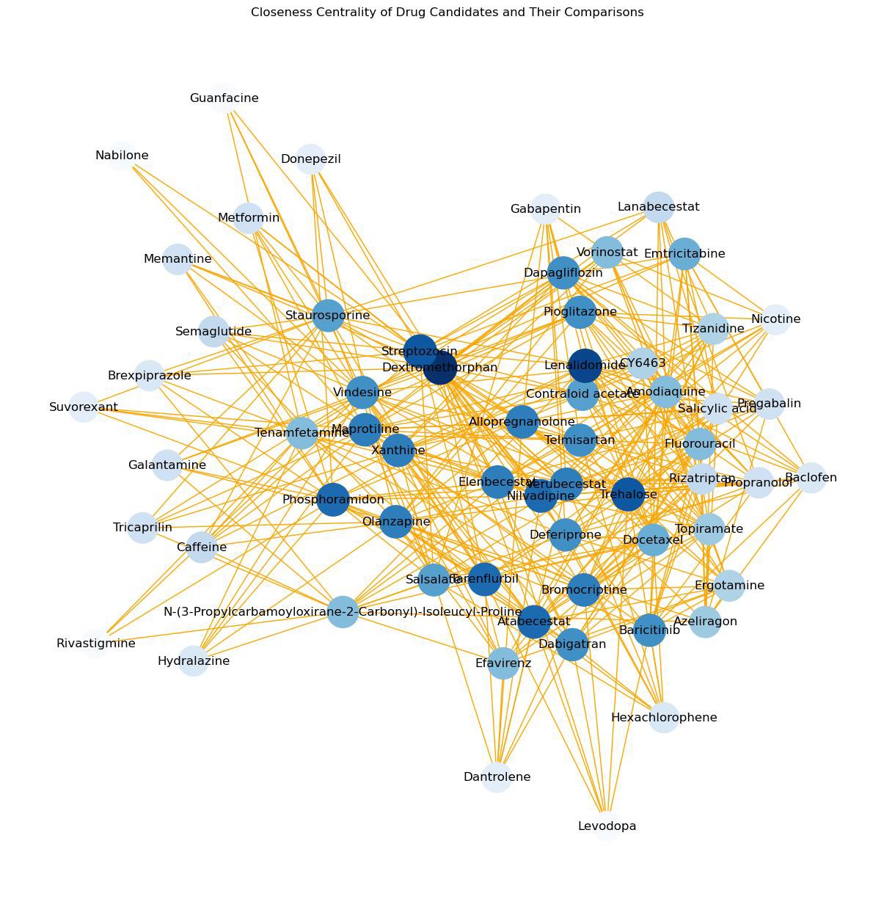
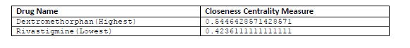
Closeness Centrality

Slide 18
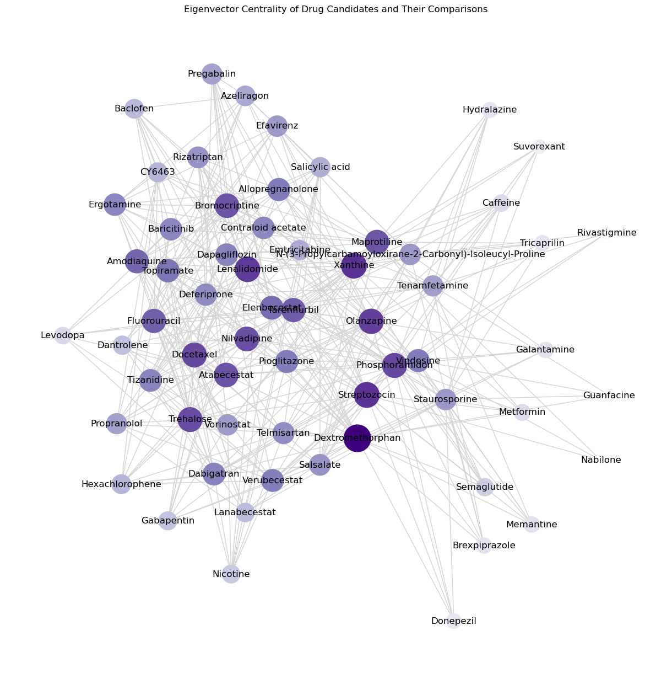
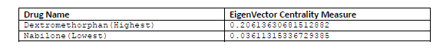
Eigen Vector Centrality

Slide 19
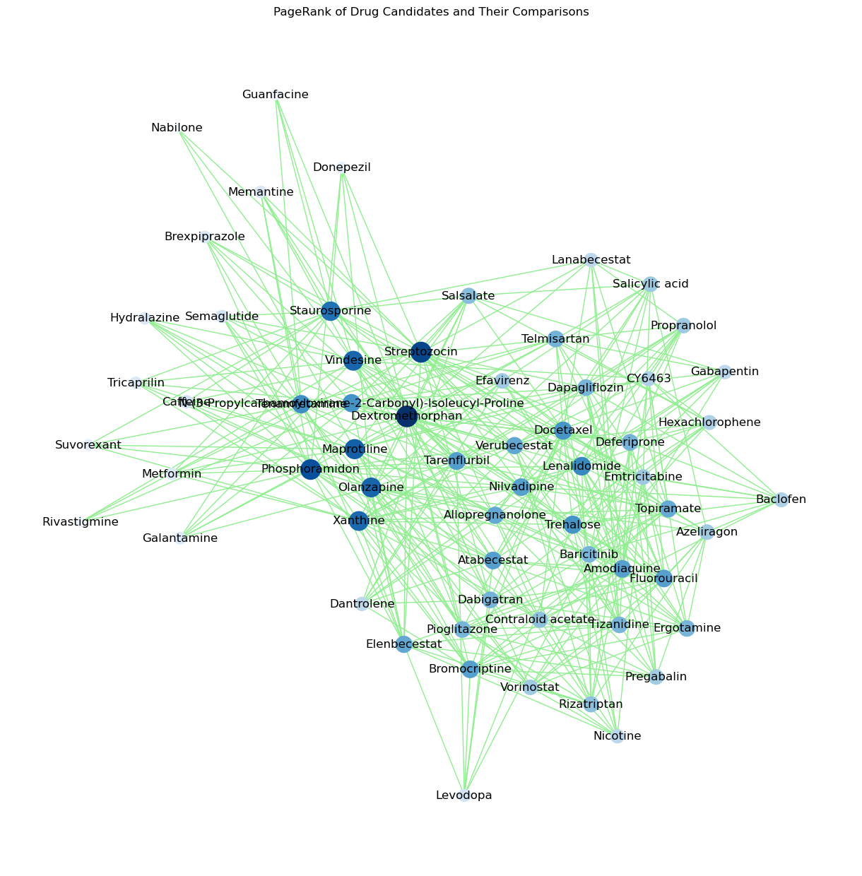
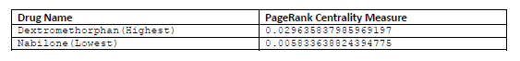
Page Rank Centrality

Slide 20
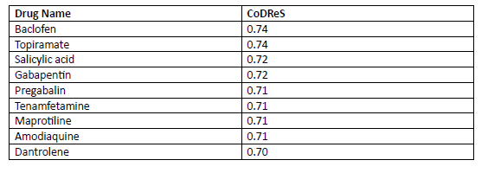
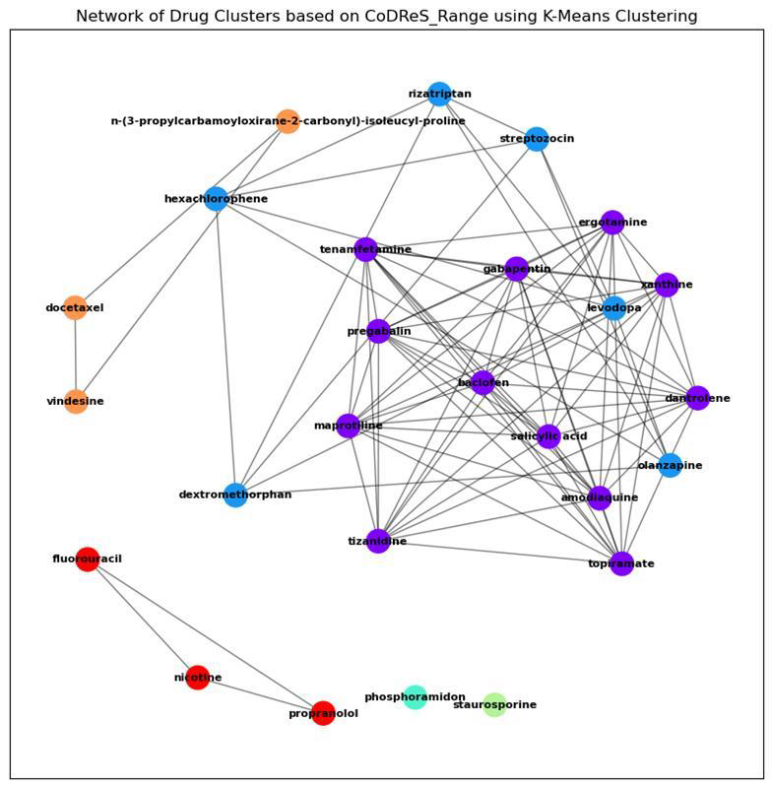
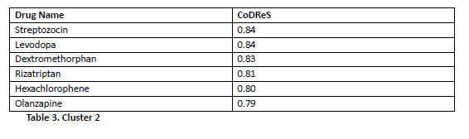
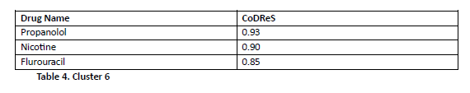
K-means Clustering

Slide 21
Discussion
Bipartite structure with 62 nodes (drugs and categories/targets), 938 edges based on Tanimoto coefficients, enabling analysis of drug-target interactions and therapeutic correlations.
Primary network focuses on drug repurposing with Tanimoto coefficient above 0.5, reducing to 371 edges, emphasizing stronger drug interactions.
Centrality measures:
Degree centrality: Dextromethorphan highest (0.377), Nabilone lowest (0.049), indicating potential repurposing opportunities.
Betweenness centrality: Dextromethorphan highest (0.0697), Nabilone lowest (~0.00075), showing network role.
Closeness centrality: Dextromethorphan highest (approx. 0.545), Rivastigmine lowest (approx. 0.424).
Eigenvector centrality: Dextromethorphan highest (approx. 0.206), Nabilone lowest (approx. 0.036).
PageRank centrality: Dextromethorphan highest (approx. 0.0296), Nabilone lowest (approx. 0.0058).

Slide 22
Discussion
CoDReS quantifies repurposing potential based on similarity to existing Alzheimer's drugs, employed with K-means clustering.
Clusters with high CoDReS values include drugs like Baclofen, Topiramate, Streptozocin, Levodopa, Propranolol, Nicotine, and Fluorouracil, indicating repurposing potential for Alzheimer's.
Future work involves further validation of these repurposed drugs for Alzheimer’s treatment.

Slide 23
Conclusion
Network analysis has identified promising drug repurposing candidates for Alzheimer's treatment, using CoDReS values and centrality metrics to focus on drugs structurally similar to existing treatments.
This approach underscores the effectiveness of network analysis in drug repurposing, offering a data-driven basis for future therapeutic development and enhancing Alzheimer's care possibilities.

Slide 24
References
Network-based stage-specific drug repurposing for Alzheimer’s disease
Alzheimer’s Disease: Key Insights from Two Decades of Clinical Trial Failures
Reasons for Failed Trials of Disease-Modifying Treatments for Alzheimer Disease and Their Contribution in Recent Research
A Web Tool for Ranking Candidate Drugs Against a Selected Disease Based on a Combination of Functional and Structural Criteria
CoDReS
DrugBank

Slide 25
Thankyou!
Questions?

